Slide 1

FRESHFLOW
Help building great products
Khushbu Gupta

Slide 2
Content
Brief of market research process
List of product features and scope
Feature prioritization using MoSCoW framework
Product roadmap
Integrations and partnership
Feature release plan and timelines
Feature specification
Low fidelity wireframe using Balsamiq
Revenue model
Marketing plan

Slide 3
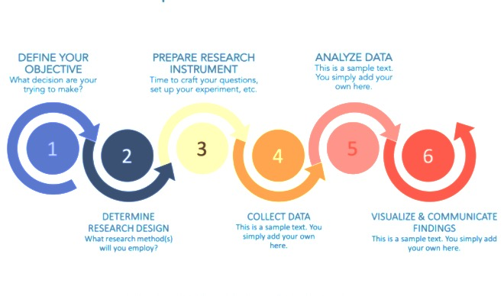
Market Research Process

Slide 4
List of Product Features and Scope
Create user account and profile
Market Research Process in-built generic templates for:
Identifying problem, goal and objective
Developing marketing plan and design
Collecting relevant data and information
Analyzing data and report finding
Putting research into actions
Market Research processes and workflows management
Market Research customizable processes and workflows management
Market Research in-built and customizable to-do task templates
Market research in-build and customizable checklist for success
Documentation Management System in-built templates for market research design :
Surveys
User interviews
Identifying target customers and focus groups
Finding total addressable market
Documentation Management System with customizable market research design templates
Collaboration with other team members to work together
Communication using chat , comments , video chat
Integrations with other supporting third party tools

Slide 5
Prioritization using MoSCoW Framework
Priority | Features | Reasoning and Logic
M Must haves | Market research process in-built generic templates Market research processes and workflow management Invite team members | We cannot launch the product without this as it is the core feature and USP of our product
S Should haves | Documentation management system in-built templates for market research design Collaborations with other team members | We should better include this but it won’t cause any disaster without them
C Could haves | Communication with team members through comments, chat, video chat. Integrations with supporting third party integration slack or email , etc.. | Nice to have features but success is not dependent on this
W Won’t haves | Market research in-built and customizable to-do task templates Market research in-build and customizable checklist for success Market research customizable processes and workflows management Documentation management system with customizable market research design templates | Won’t implement this at this point of time, maybe later

Slide 6
Roadmap
Priority | Feature | Quarter | Strategy | Vision
P0 | Market Research process inbuilt template | Q3,2020 | Market research process management | Ease market research process
P0 | Create Process and Workflow management Invite and add team members | Q3, 2020 | Market research process management | Ease market research process
P1 | Market research design inbuilt template | Q4,2020 | Market research process management | Ease market research process
P1 | Documentation Management | Q4,2020 | Market research process management | Ease market research process
P2 | Slack Integration Allow team member to comment | Q1,2021 | Collaboration and coordination | Connect distributed team members
P3 | Market research in-built and customizable to-do task templates Market research in-build and customizable checklist for success | Q1,2021 | Market research process management | Connect distributed team members
P4 | Documentation management system with customizable market research design templates | Q2,2021 | Market research process management | Ease market research process
P4 | Text and Video chat | Q2,2021 | Communication | Ease market research process

Slide 7
Feature Release Timeline
Release | Priority | Feature | Working Quarters | Tentative Release Timelines
1st Release | P0 | Market Research process inbuilt template Process and Workflow management Invite and add team members | July - Sep,20 | Mid October,20
2nd Release | P1 | Market research design inbuilt template Documentation Management | Oct - Dec,20 | Start of Jan,20
3rd Release | P2,P3 | Slack Integration Allow team member to comment Market research in-built and customizable to-do task templates Market research in-build and customizable checklist for success | Jan - March,20 | Mid of April,20
4th Release | P4 | Documentation management system with customizable market research design templates Text and Video chat | April –June,20 | Start of July,20

Slide 8
Feature Spec – Market research design process
Please find the functional specification of Market research design process here

Slide 9
UX Flow
Link to Balsamiq low fidelity wire framing is here
Download wireframe pdf from Google drive here

Slide 10
Integration and Partnership
Integration with tools
Slack
Email
Partnership
Consulting
Technology
Trello
JIRA
Notion
Platform

Slide 11
Subscription Revenue Model
The revenue model suggested for FreshFlow is subscription based revenue model.
Customer will pay in installments for accessing the product and avail the service billed either monthly or annually.
Subscription model is suggested based on target user groups and personas like individuals /distributed team, small/startup teams, business and enterprise teams.
Team size | Plan | Subscription costs
Any - limited period trial version | Basic | Free
Individuals / distributed team | Standard | $19/m
Small / startup team | Pro (advanced features) | $39/m
Medium business team | Premium ( premium features) | $79/m

Slide 12








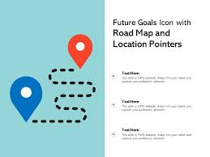
Marketing Plan
Ease and Simplify market research process
Startups , SMBs , distributed teams
Productboard
Monday.com
Teamwork
Events
Startup summits
Campaigns
Social Media
Ads
LinkedIn
Startup Blogs and You-tube
Post Q3,2020
10% of expected ROI
Market research specialized - Product management tool
Loyal Customers
Simplified solution for
building products

Slide 13
Thank You!

